Slide 1

Information-Retrieval Search Engine Project
By Victor Gavrilenko & Ilay Cohen

Slide 2
Preprocessing 1:
Wikipedia dump files
Google Cloud
Created multiple .bin files that were used as words-to-article_id dictionary
A.K.A Inverted index
Then created .pkl file to be used as word-to-bin_file dictionary
Uploaded to
Using PySpark

Slide 3
Preprocessing 2:
Google Cloud
Inverted Index, Title length Dictionary and Doc id to Title Dictionary
Title
Tokenize, Stopwords & Stem
Doc Body
Tokenize, Stopwords & Stem
Inverted Index, Doc L2 Norm Dictionary and Body Length Dictionary
Anchor Text
Page Rank Dictionary
Page View Dictionary

Slide 4
Preprocessing 3:
Running Python server using Flask on google cloud cluster
Loads all .pkl files from the google cloud
bucket
Waits for user input

Slide 5
During Runtime:
User
Result as Json
Server:
Query
GCP
Redistributing weight between title and body based on if query is question or not
Tokenizing and stemming user’s input
Title
Similarity based on BM25 algorithm
Sorting results and slicing for best 30
Body

Slide 6
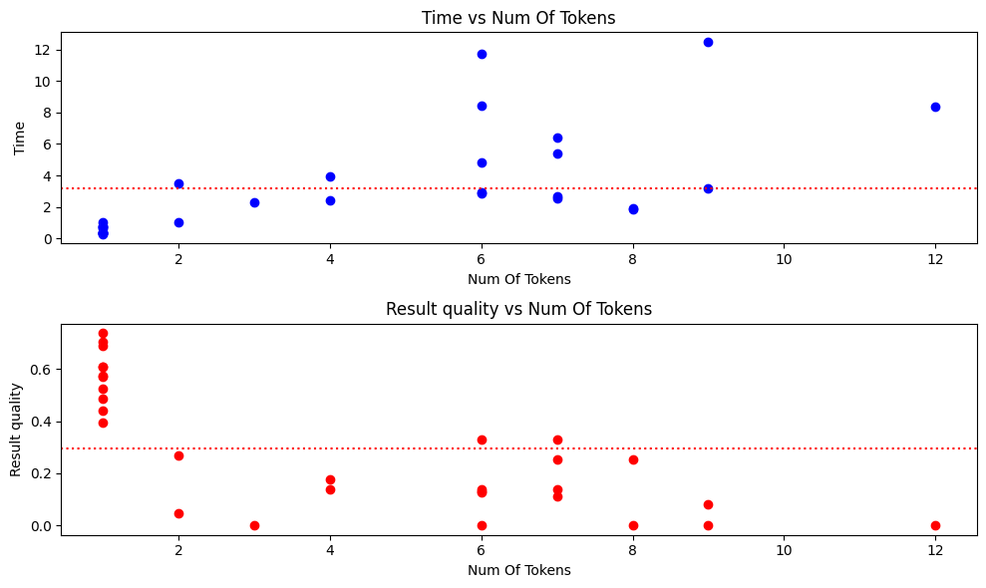
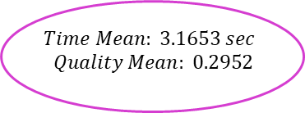
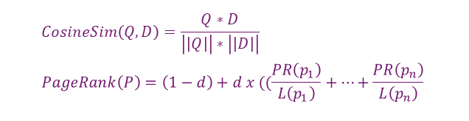
First Experiment – Cosine Similarity & Page Rank
Body Cosine Similarity
Return Best N Results
Merge Results:
Title Weight: 0.7
Body Weight: 0.3
Query
Tokenize, Stopwords & Stem
Title TF + PageRank
$$CosineSim\left(Q,D\right)=\frac{Q∗D}{\left|\left|Q\right|\right|∗\left|\left|D\right|\right|} \\ PageRank\left(P\right)=\left(1−d\right)+d x ((\frac{PR\left(p_{1}\right)}{L\left(p_{1}\right)}+…+\frac{PR\left(p_{n}\right)}{L\left(p_{n}\right)}$$
$$Time Mean: 3.1653 sec$$
$$Quality Mean: 0.2952$$

Slide 7
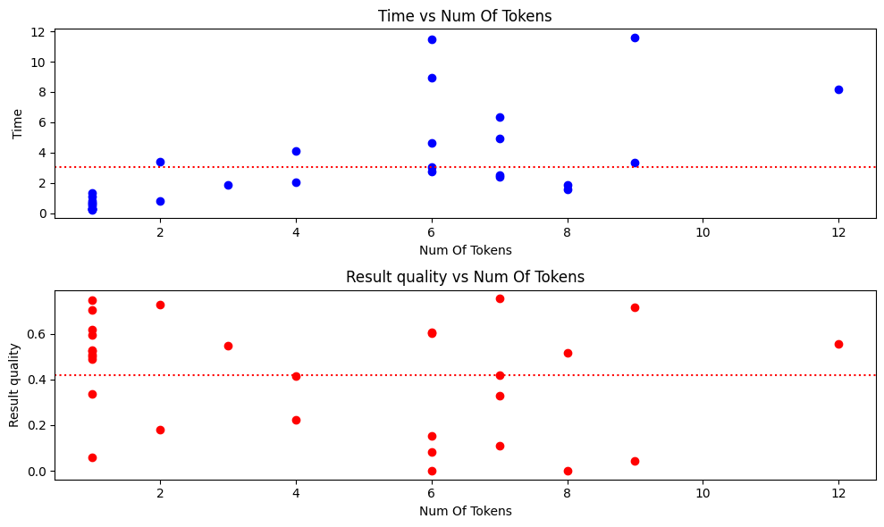

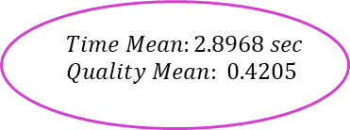
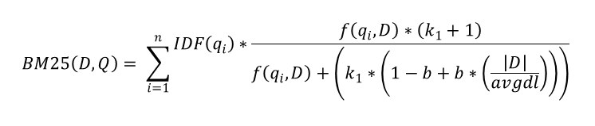
Second Experiment – BM25 with Page Rank & Page Views
Body MB25 with k1=1.75 & b=0.65
Merge BM25 results for questions and non-question + $\log_{e}\left(PageRank\right)+\log_{6}{(PageView)}$
Return Best N Results
Query
Tokenize, Stopwords & Stem
Title BM25 with k1 =2.2 & b=0.85
$$Time Mean:2.8968 sec$$
$$Quality Mean: 0.4205$$
$$BM25\left(D,Q\right)= \sum_{i=1}^{n}{\begin{aligned}IDF\left(q_{i}\right)∗\frac{f\left(q_{i},D\right)∗\left(k_{1}+1\right)}{f\left(q_{i},D\right)+\left(k_{1}∗\left(1−b+b∗\left(\frac{\left|D\right|}{avgdl}\right)\right)\right)} \\ \end{aligned}}$$

Slide 8
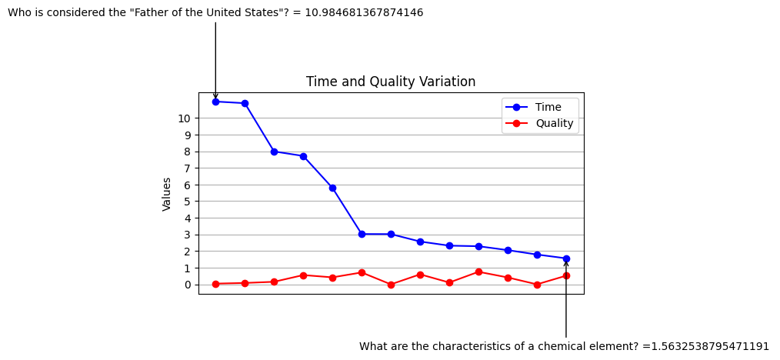
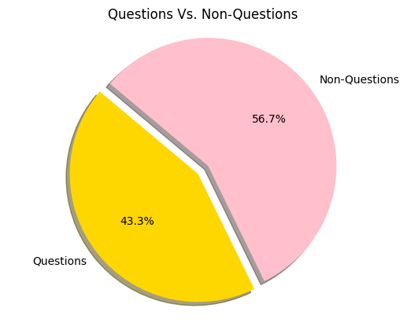
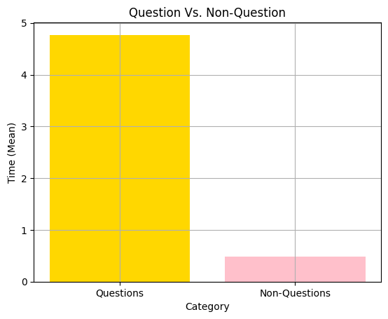
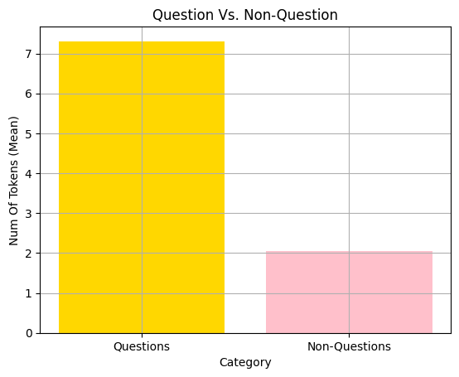
Understanding Poor Results:
['state', 'unit', 'consid', 'father'] ['element', 'chemic', 'characterist']

